Slide 1
Categories of Funding Relevant to Graduate Students
Dissertation Improvement or Research Grants
  Provide funds specifically to support research leading to a dissertation
Study Abroad Fellowships
  Often Foundations, limited in time and amount
Visiting Student Fellowships
  Funds to travel to a specific site or institution for research or educational purposes (variable time and amount)
Travel Grants
  Professional meeting or research site (e.g., CARE)
Training Grants
  T32, F31, F32 (NIH)
General Research Grants open to students
  Mostly grad students cannot be PI but some exceptions, e.g., CTSI pilot project awards

Slide 2
Categories of Funding Relevant to Graduate Students
Graduate Assistantships
  Through College or Department, covers tuition plus stipend, application process varies by program
Scholarship Programs
  Vary widely by source, level of support, focus
Graduate Fellowships
  Covers tuition, stipend, plus often small amount for supplies/travel (time limited) (e.g., Jacqueline Goldman Fellowship Program in Developmental Psychology)
Dissertation Fellowships
  Funds to complete dissertation, variable in time and amount
Office of Research, Research Program Development
www.research.ufl.edu/research-program-development.html
Jenn Hubbs hubbsj@ufl.edu

Slide 3
UF Division of Research Program Development
Find Funding for Research
Assistance with Grant Writing
Internal Seed Grant Programs
Limited Submission Opportunities
Facilitating Industry Collaborations

Slide 4
Finding Funding
Identify Activity (research, dissertation. conference, travel, equipment etc.)
Develop keywords
Search databases
Sign up for e-mail alerts

Slide 5
Finding Funding
http://research.ufl.edu/faculty-and-staff/finding-funding.html
The Division of Research Program Development assists UF faculty and staff in the pursuit of internal and external research funding
Identifies and publishes a list of Funding Opportunities for the UF community
Coordinates the selection of UF’s nominees to limited submission programs
Facilitates industry partnerships
Coordinates the annual Research Opportunity Seed Fund program
Assists in planning and coordinating large interdisciplinary research initiatives, including facilitating the preparation of grants
Maintains a list of grantsmanship resources and boilerplate text to assist all faculty submitting proposals.

Slide 6
Funding Sources
Internal
Department & College
University-wide opportunities
External
Professional Organizations
Government Agencies
Foundations
Industry
Office of Research
Research Program Development
www.research.ufl.edu/research-program-development.html
Jenn Hubbs hubbsj@ufl.edu

Slide 7
Internal Competitive Funding
Faculty
http://research.ufl.edu/faculty-and-staff/finding-funding/internal-competitive-funding.html
UF Research Foundation Awards
UFRF Professorship Awards
Support for New Training Grants (matching funds)
Research Opportunity Seed Fund
Preparatory Grant Program: Enhancing Competitiveness for Externally Funded Major Grant Opportunities
Other Internal Support Programs for Faculty
Fine Arts and Humanities Scholarship Enhancement Fund

Slide 8
Internal Support Programs
Students
http://research.ufl.edu/faculty-and-staff/finding-funding/internal-competitive-funding.html
Graduate Student Travel Funds
Maximum $400 + 1:1 match by college/department
•Presentation at national meeting OR unique off-site research experience
•Apply minimum 1 month before travel
•Priority to doctoral-level students
Graduate Student Council Travel Grants
http://gsc.sg.ufl.edu/grants/
•$350 reimbursement-based awards, funding up to half of travel costs
•For graduate students presenting their research or participating in professional development at conferences
•Submit at least 6 weeks before conference
Grinter Fellowships

Slide 9
Institutional Training Grants
Institution-level awards that support a certain number of graduate “trainees” (e.g., NIH T32)
UF faculty apply for these funds and carry out the training program
The graduate program(s) involved solicit applications from interested students in a variety of ways

Slide 10
Other UF Programs
Clinical and Translational Science Institute (CTSI) Awards (Pilot and Collaborative Projects Program; Training and Professional Development Programs)
UF Health Cancer Center Seed Grants (Bridge Grants, Cancer-Aging Collaborative Team Grants, Collaborative Grants, Pilot Project Awards, and Triple Negative Breast Cancer Research Grants)
International Center – Internationalizing the Curriculum Awards
Center for Latin American Studies – Field Research Grants for Graduate Students
Center for European Studies Funding Opportunities (e.g. course development, travel grants)
UF Water Institute Program Initiation Fund
Emerging Pathogens Institute (EPI) Seed Funding and Resubmission Support
The Florida High Tech Corridor Council Matching Funds Research Program at UF

Slide 11
Other UF Programs
Continued
UF Center for the Humanities and the Public Sphere Grant and Fellowship Opportunities
W. Martin Smith Interdisciplinary Patient Quality and Safety Awards (IPQSA) Program
UF Creative Campus Initiative – Catalyst Fund
STEM/CTSI Translational Communication Research Pilot Award Program
Faculty Enhancement Opportunity
IFAS Program Announcements (topics and eligibility vary by year)
Florida Alzheimer’s Disease Research Center – Pilot Awards

Slide 12
External: Government Funding Resources
http://www.grants.gov/
https://www.usa.gov/federal-agencies/a
https://www.fedconnect.net/FedConnect/default.htm
https://nifa.usda.gov/
https://www.nsf.gov/funding/
https://grants.nih.gov/funding/index.htm

Slide 13
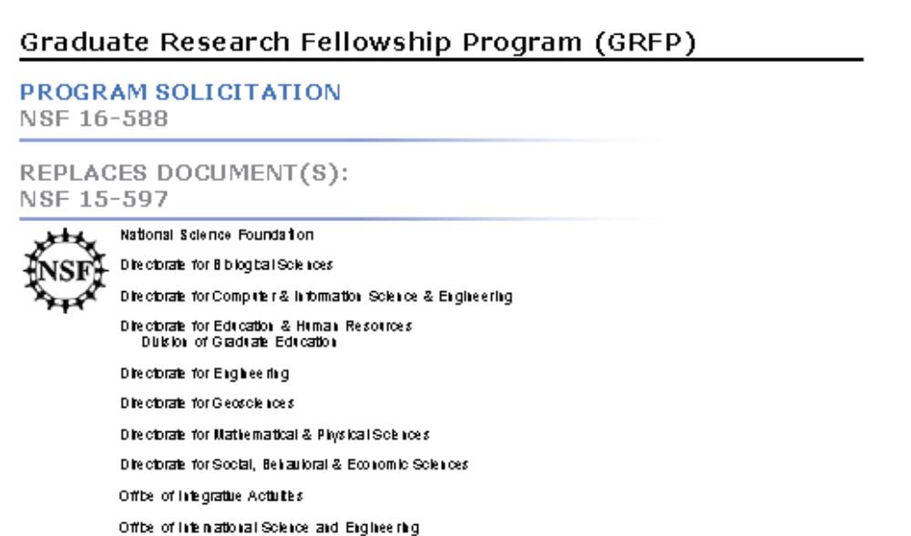
NSF Individual Research Fellowships
https://www.nsfgrfp.org/

Slide 14
NIH Individual Fellowships
https://researchtraining.nih.gov/
Ruth L. Kirschstein Individual Pre-doctoral NRSA for MD/​PhD and other Dual Degree Fellowships (F30)
Ruth L. Kirschstein Pre-doctoral Individual NRSA (F31)
Ruth L. Kirschstein Post-doctoral Individual NRSA (F32)
Individual Pre-doctoral to Post-doctoral Fellow Transition Award (F99/K00) (1 nominee per institution).

Slide 15
General Research Grants
Some regular research grants are open to graduate students to apply for them directly
Your advisor may need to sign off on the award
Read eligibility language closely on grants of interest – you might be eligible to be the Principal Investigator (PI)
Example – UF Clinical & Translational Science Pilot Project Awards: provides funding for early-stage clinical research projects, and graduate students may apply directly

Slide 16
Searchable Databases (Government and Foundation Opportunities)
UF Research Program Development website
http://research.ufl.edu/research-program-development/external-funding.html
COS Pivot Funding Opportunities
  http://pivot.cos.com/
Grant Forward (requires subscription)
https://www.grantforward.com

Slide 17
COS Pivot Funding Database
http://research.ufl.edu/faculty-and-staff/finding-funding/cos-pivot-funding-database.html
Searchable funding opportunities and expertise database
Available to all UF faculty, staff and students, who may register for free
Search UF Database of Faculty Expertise on COS Pivot
Search Database of Funding Opportunities on COS Pivot
Video tutorial
COS Pivot Funding Alerts/Saved Searches: This service runs automatically once a week. You must be a registered user of COS Pivot and must set up a Saved Search for each query for which you would like to receive a Funding Alert (video tutorial)
Description of COS Pivot services and access to a variety of training resources, including written instructions, videos, and webinars, at http://pivot.cos.com/support.
For assistance with Pivot Profiles, see the Pivot Support Pages or contact the Division of Research Program Development in the Office of Research.

Slide 18
Foundation Grants
http://foundationcenter.org/find-funding/fdo-quick-start
Foundation Directory Online Quick Start
FDO Quick Start is a quick and easy-to-use tool for looking up key information on all U.S. foundations.
FDO Quick Start
Foundation Directory Online offers a free search tool, FDO Quick Start, providing free, public access to essential information about over 100,000 foundations.
Funder profiles include:
Address and contact information
Fields of interest
Program areas
Fiscal information

Slide 19
Subscribe to Free Grant Alerts
National Science Foundation Update
NIH Guide Weekly Table of Contents
Grants.gov – Daily postings from all federal grant-making agencies.
NASA (Select “Getting an Account” and register. At the end of the registration process, you will be prompted to select the email subscriptions you prefer.)
National Endowment for the Humanities
The Foundation Center’s Newsletters

Slide 20
Other Email Funding Alerts
NSF (Daily or Weekly)
http://www.nsf.gov/publications/obtain.jsp
NIH Guide TOC (Weekly)
http://grants1.nih.gov/grants/guide/listserv.htm
Grants.gov (Daily)
http://www.grants.gov/web/grants/manage-subscriptions.html
Foundation Center RFP Bulletin (weekly) or Philanthropy News Digest daily alerts – and Foundation Center Funding Watches (choose arts, health, or education)
http://foundationcenter.org/

Slide 21
UF Funding Opportunity Manager Page
http://research.ufl.edu/funding
Updated daily with opportunities for which UF is eligible
Includes federal, state, foundation, and UF-internal funding opportunities
Focuses on research funding opportunities for faculty, with some for postdocs and students
Sign up for regular email digest of opportunities published in various categories (e.g. Science & Engineering, Postdoc)
This is where UF posts guidelines for internally-coordinated limited submission opportunities – always check here before applying!

Slide 22
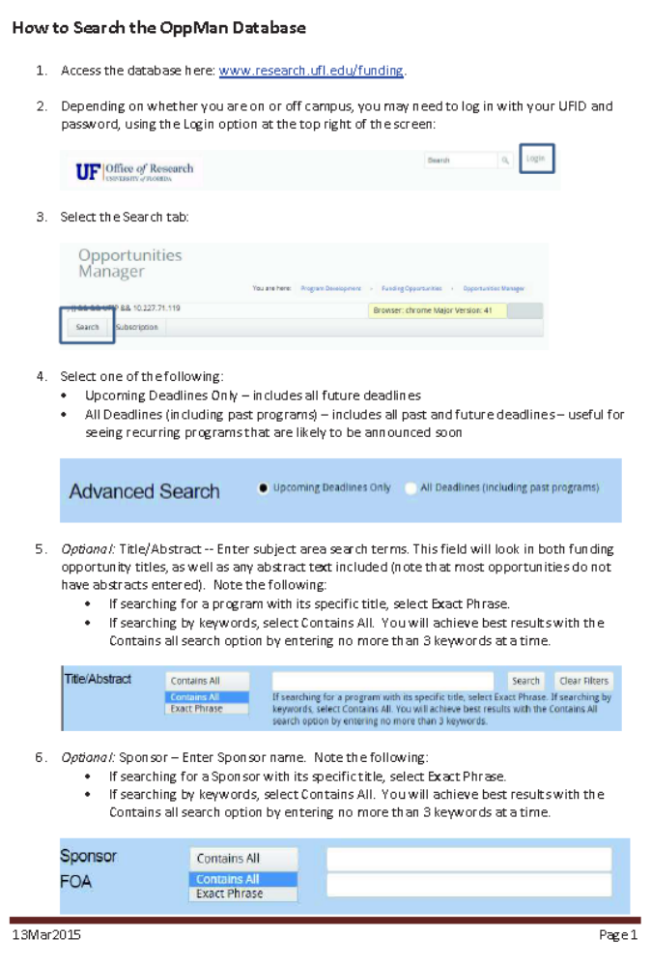

Slide 23
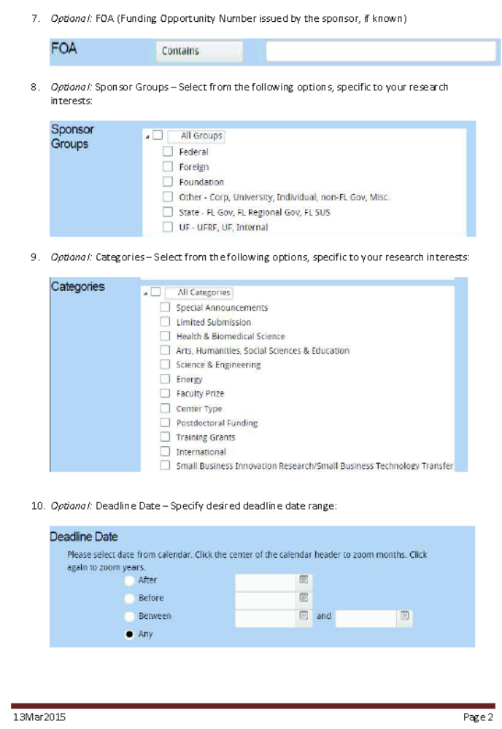

Slide 24
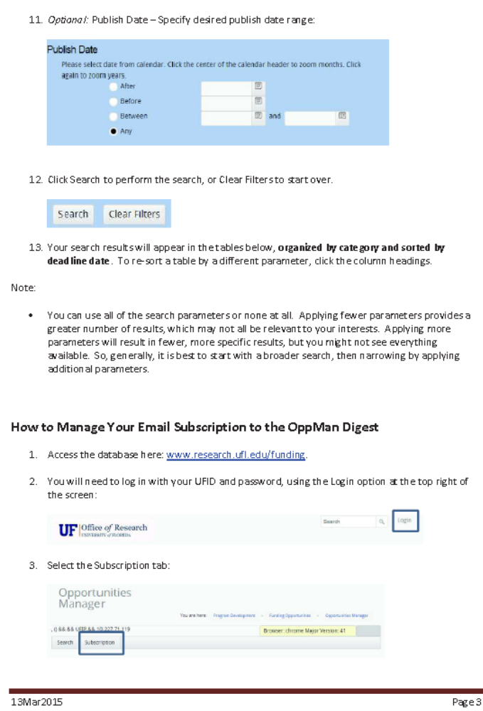

Slide 25
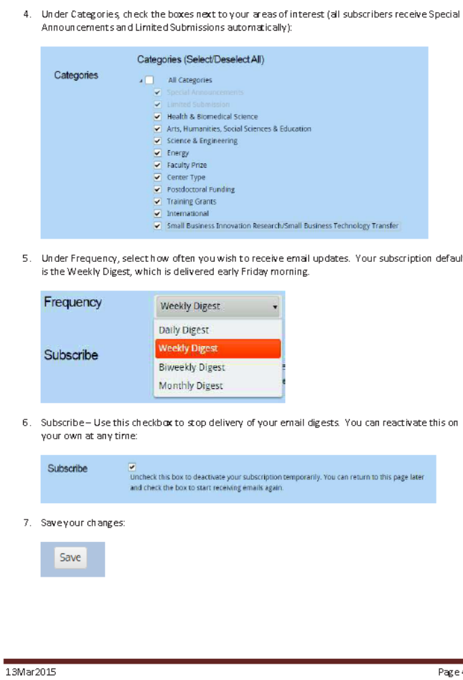

Slide 26
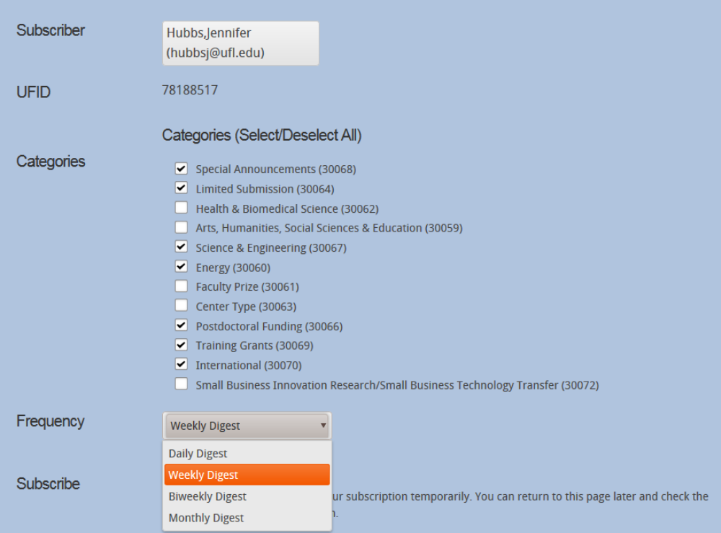
Email Alerts for New Opportunities

Slide 27
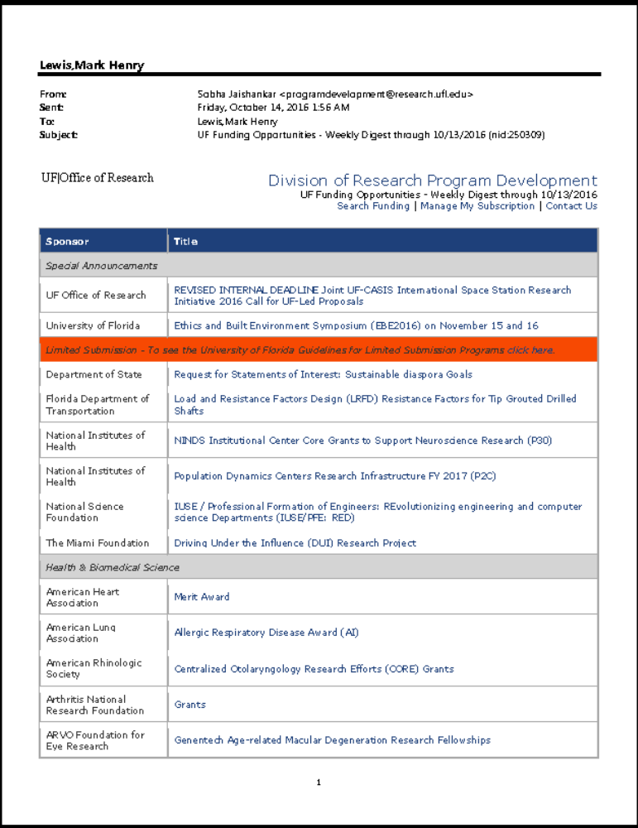

Slide 28
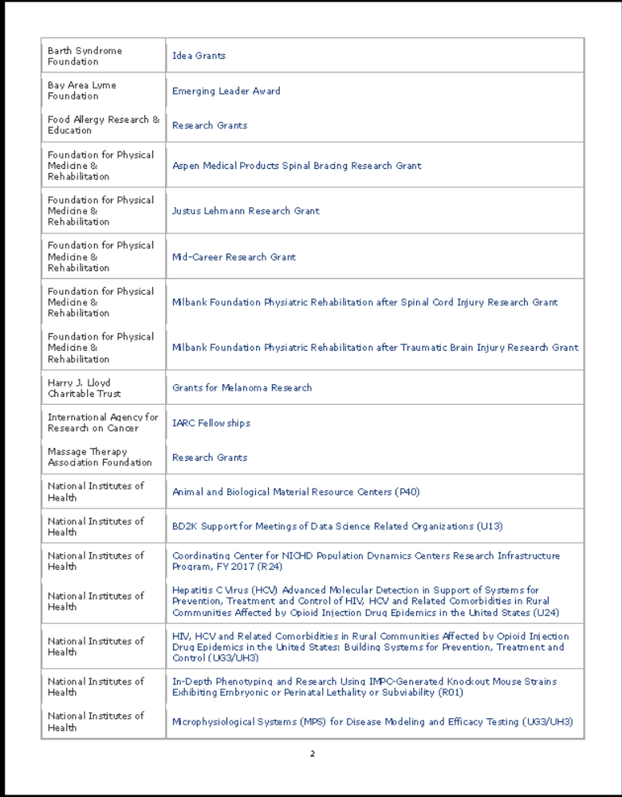

Slide 29
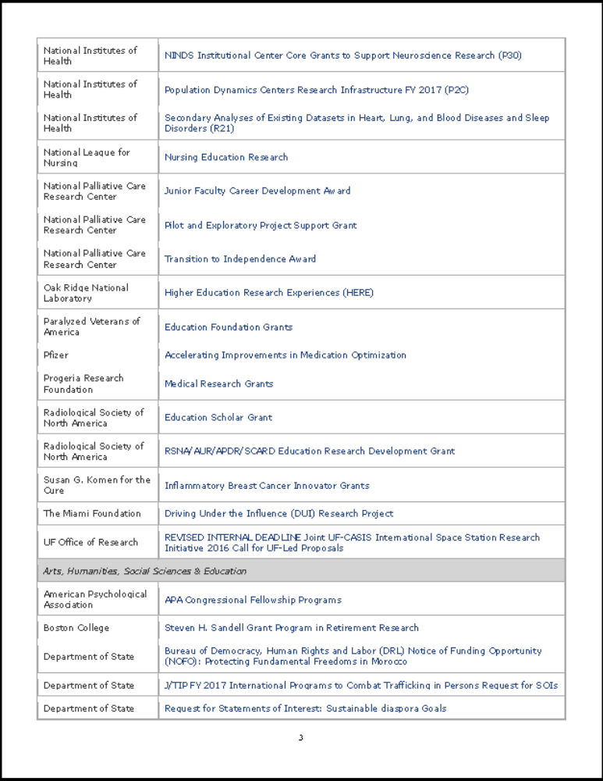

Slide 30
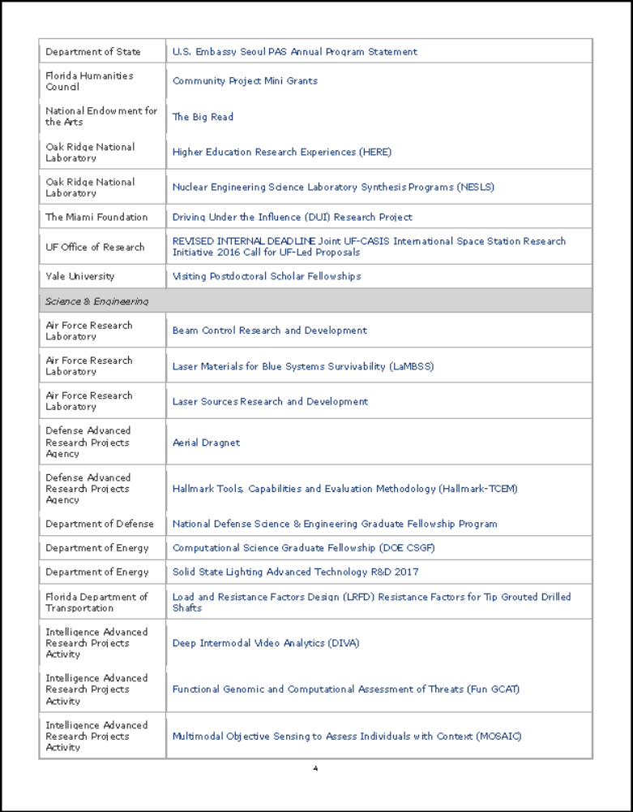

Slide 31
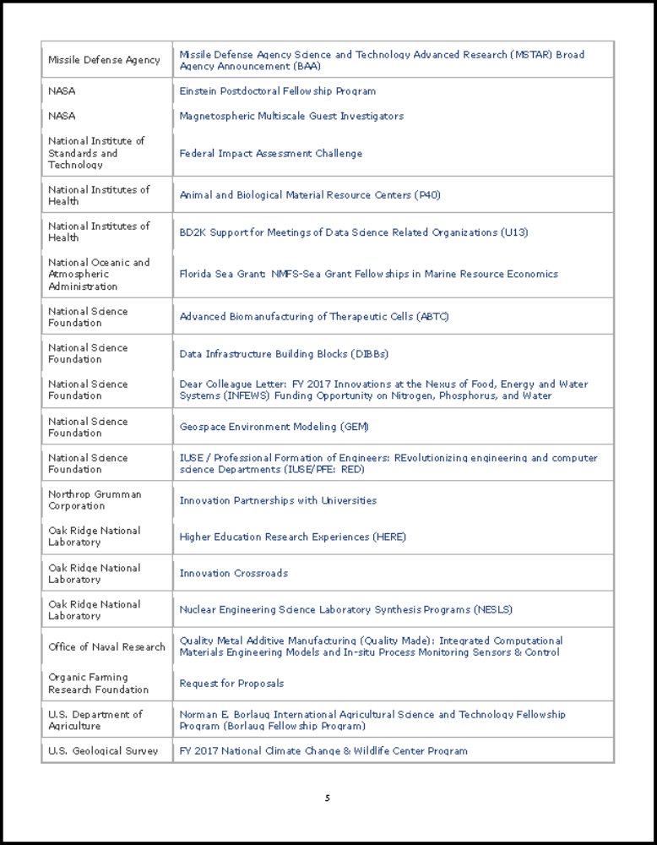

Slide 32
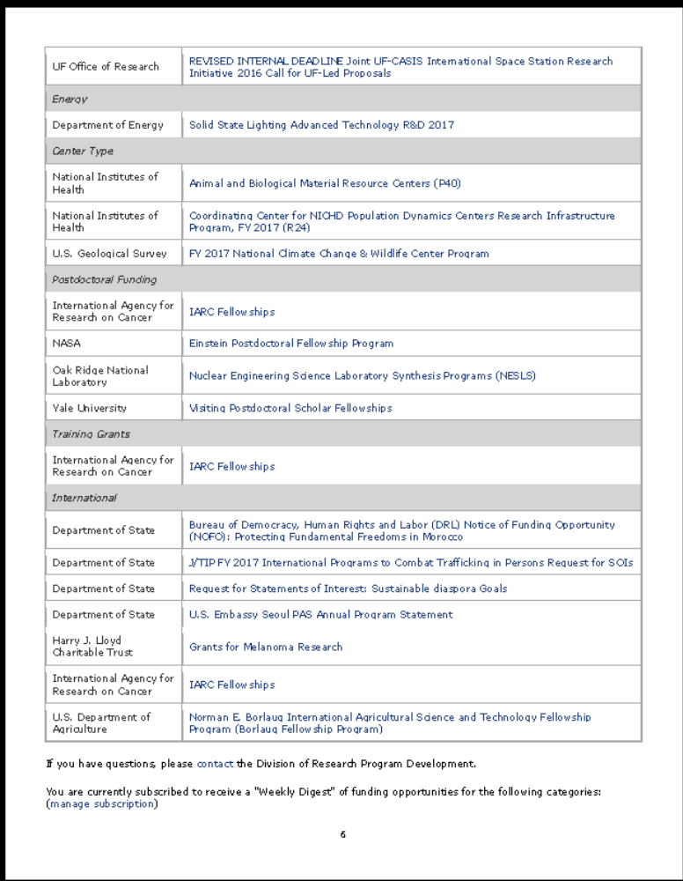

Slide 33
Key Takeaways
Know what kind of funding you need
Formulate some keywords that describe your research in both broad and narrow terms
Cast a broad net to see as many opportunities as possible
Sign up for email alerts of new funding opportunities
Check eligibility and focus areas of possible opportunities and previously funded projects to make sure what you’re proposing is fundable by this source
Use your funded colleagues and funded faculty as examples of what to look for
Use the resources UF provides (Office of Research, Libraries, Graduate Advisors)
Office of Research, Research Program Development
www.research.ufl.edu/research-program-development.html
Jenn Hubbs hubbsj@ufl.edu

